Slide 1
Cloud Computing
SEWP ZG527

Slide 2


IaaS
Really, what is iaas???
Notes:
RL 3.1

Slide 3
Amazon Web Services
Amazon Web Services Cloud
Provides highly reliable and scalable infrastructure for deploying web-scale solutions
With minimal support and administration costs
More flexibility than own infrastructure, either on-premise or at a datacenter facility
Notes:
RL 3.2

Slide 4
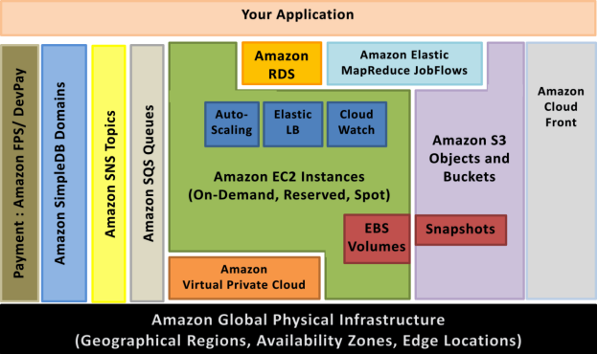
AWS infrastructure services

Slide 5
Amazon Elastic Compute Cloud (Amazon EC2)
Web service that provides resizable compute capacity in the cloud
Can be bundled with OS, application software and associated configuration settings into an Amazon Machine Image (AMI).
Use these AMIs to provision multiple virtualized instances
Decommission them using simple web service calls to scale capacity up and down quickly, as capacity requirement changes.
On-Demand Instances - pay for the instances by the hour
Reserved Instances - pay a low, one-time payment and receive a lower usage rate to run the instance
Spot Instances - bid for unused capacity and further reduce your cost.
Instances can be launched in one or more geographical regions.
Each region has multiple Availability Zones. Availability Zones are distinct locations that are engineered to be insulated from failures in other Availability Zones

Slide 6
Infrastructure Services
Elastic IP addresses - allocate a static IP address and assigned to an instance.
CloudWatch: Enable monitoring Amazon EC2 instance - - visibility into resource utilization, operational performance, and overall demand patterns (including metrics such as CPU utilization, disk reads and writes, and network traffic).
Auto-scaling - to automatically scale capacity on certain conditions based on metric that Amazon CloudWatch collects.
Elastic LB – distribute incoming traffic by creating an elastic load balancer
Amazon Elastic Block Storage (EBS) - volumes provide network-attached persistent storage to Amazon EC2 instances.

Slide 7
Infrastructure Services
Amazon S3 is highly durable and distributed data store. With a simple web services interface, store and retrieve large amounts of data as objects in buckets (containers) at any time, using standard HTTP
Amazon SimpleDB - Provides the core functionality of a database, real-time lookup and simple querying of structured data
Amazon Relational Database Service - provides an easy way to setup, operate and scale a relational database in the cloud.
Amazon Elastic MapReduce - provides a hosted Hadoop framework
AWS Identity and Access Management (IAM) – enables multiple User creation with unique security credentials and manage the permissions for each of these Users

Slide 8
Examples
AWS – EC2, EBS, S3, LB

Slide 9
IaaS for you
Thanks, I feel so “Clouded” now

